Slide 1



LinkedIn Summary
DEPI Graduation Project 2024
Instructor: Ahmed Abdellatif
AST Company

Slide 2
Team and Roles
Ahmed
Ragab
Ahmed
Gamal
Logain
Emad
Saleh
Mohamed
Hager
Wael
Blueprint Diagram
Summary
Dashboard
Data Cleaning
EDA
Visualization
Report
Data Modelling
Data Modelling

Slide 3
Agenda
ERD & Mapping
Intro
Report
Dashboard

Slide 4


Introduction
This dataset contains over 124,000 job postings from 2023 and 2024 on LinkedIn, with key details like title, description, salary, location, application URL, and work types (remote, contract, etc.). Separate files cover benefits, skills, industries, and company data (e.g., description, headquarters, size, follower count). The dataset allows for exploring top-paid roles and analyzing industry trends. Future updates will include time-based insights on company growth, remote job trends, and job title demand.

Slide 5
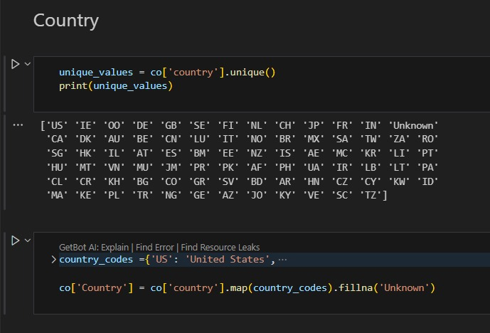
Data Cleaning
Replacing countries' abbreviations with their real names

Slide 6
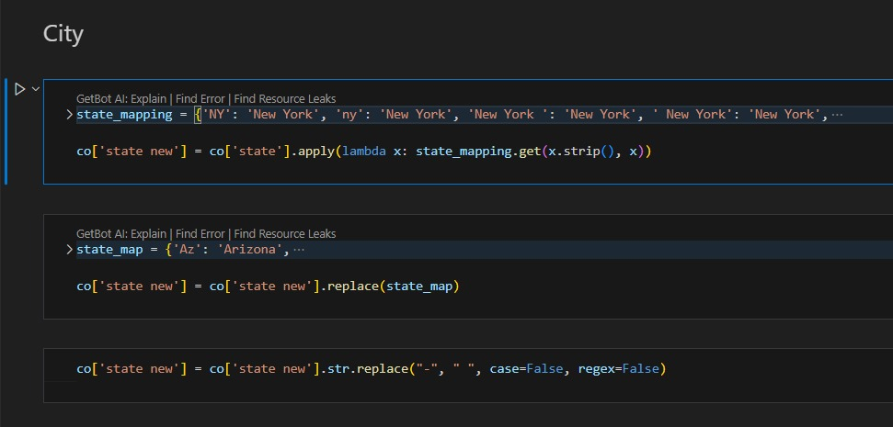
Data Cleaning
Replacing cities' abbreviations with their real names

Slide 7
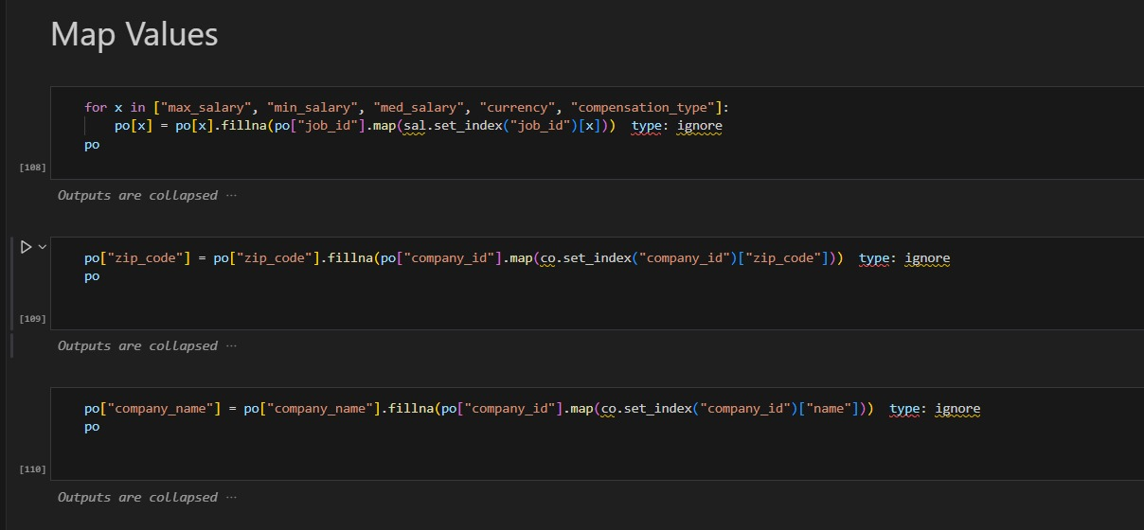
Data Cleaning
Create a map between tables to fill in the nulls

Slide 8
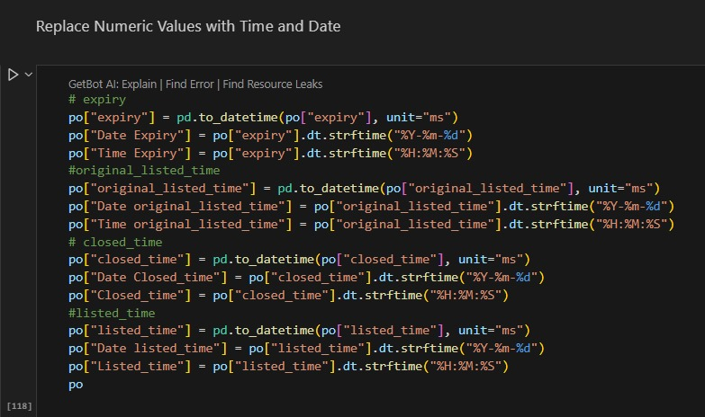
Data Cleaning
Replace Numeric Values with Time and Date like 1713397508000

Slide 9
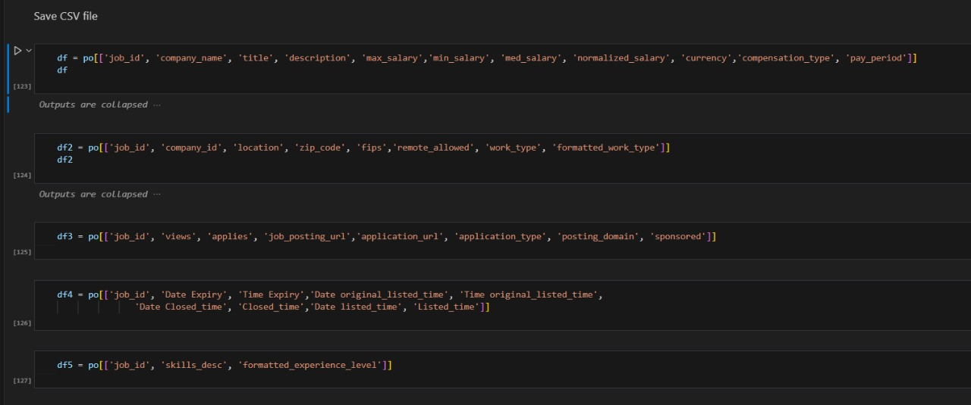
Data Cleaning
Convert Posting file to 5 separate files

Slide 10
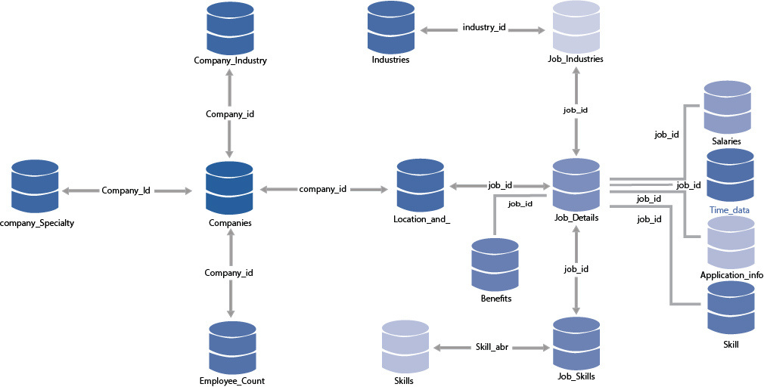
ERD

Slide 11
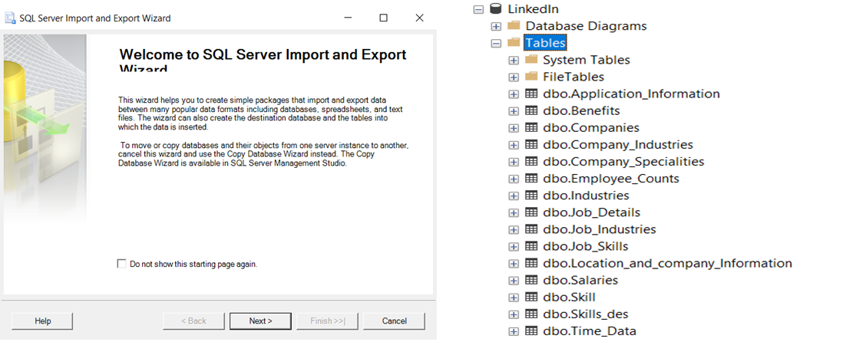
Data Modeling
1.Insert the cleaned data into MS SQL Server Management Studio using Wizard

Slide 12
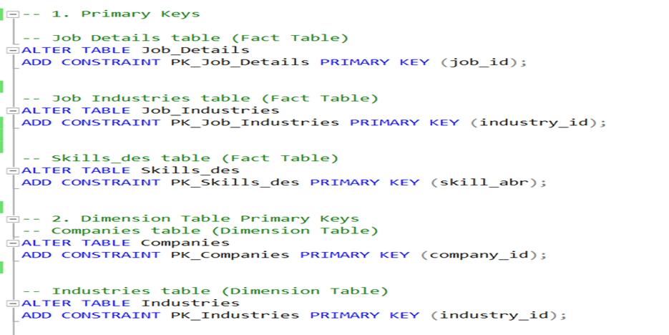
Data Modeling
2. Primary Key for and Dimensional Tables

Slide 13
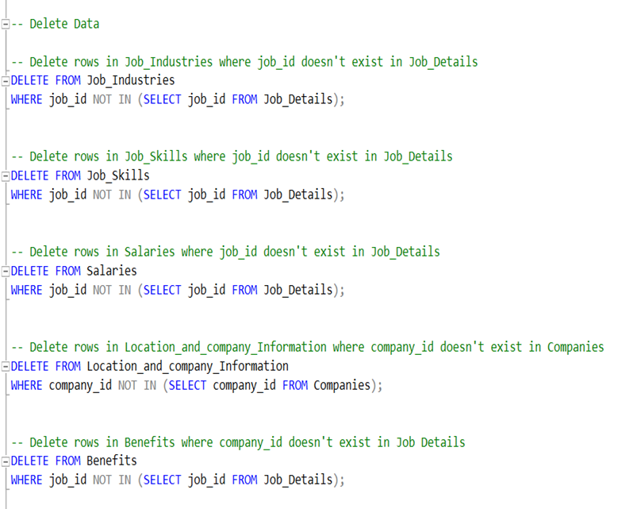
Data Modeling
3.Link PK and FK with the tables
Before this step I faced a problem with this link bcz the FK table have more values than PK tables, so I solved this problem by delete the data I don’t need it and solved this problem.

Slide 14
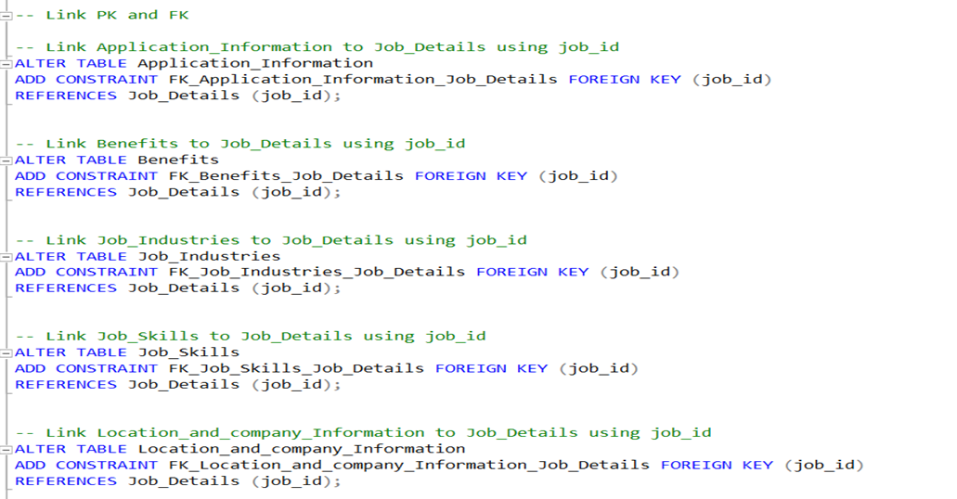
Data Modeling
4. After solved this problem the next step was the link PK and FK

Slide 15
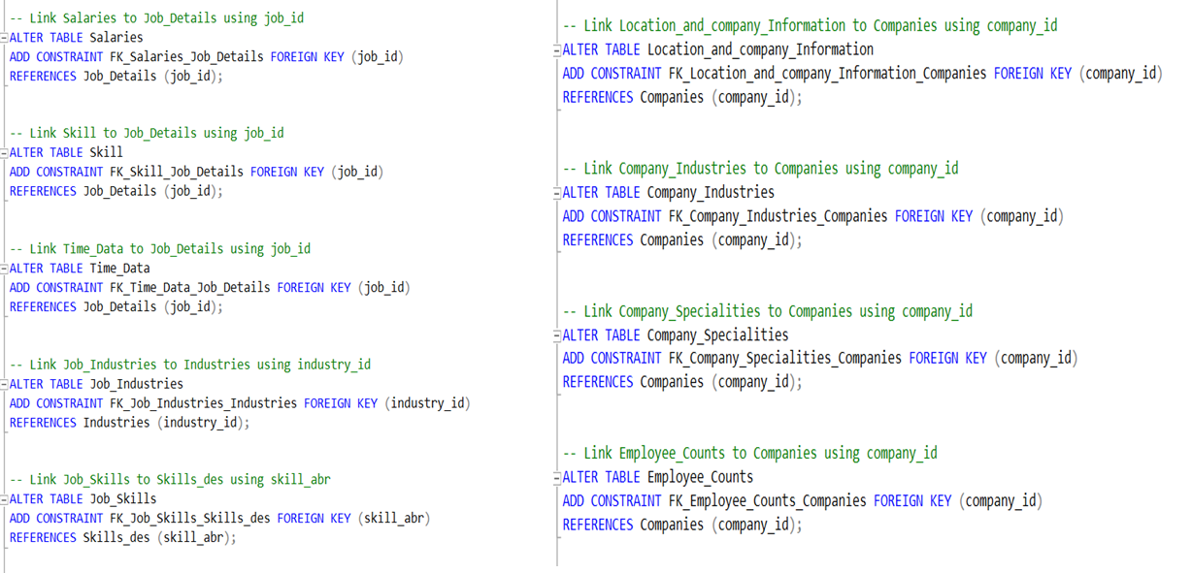
Data Modeling

Slide 16
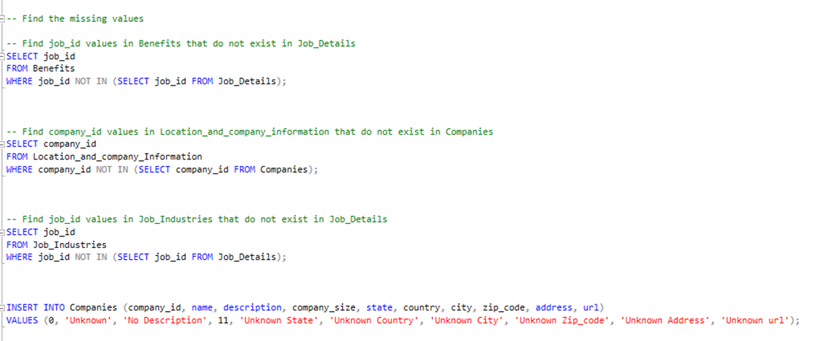
Data Modeling
And used these codes to find the data that I didn’t need it and insert row with Companies table to solve a problem.

Slide 17
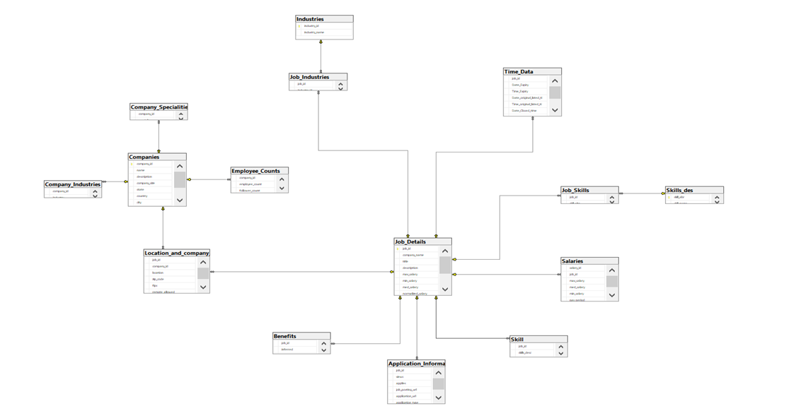
Data Modeling Diagram

Slide 18

EDA Using Python

Slide 19
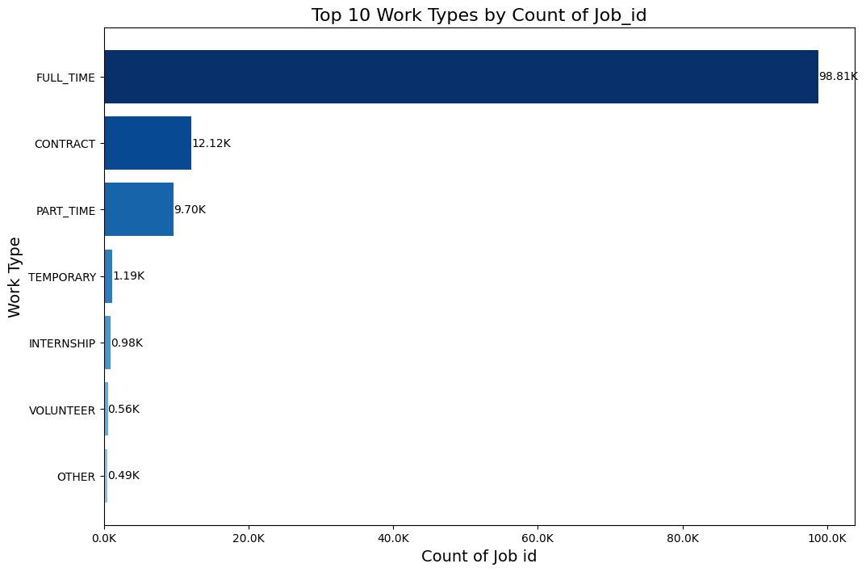
EDA Using Python
Top 10 Work Types by Count of Job_id

Slide 20
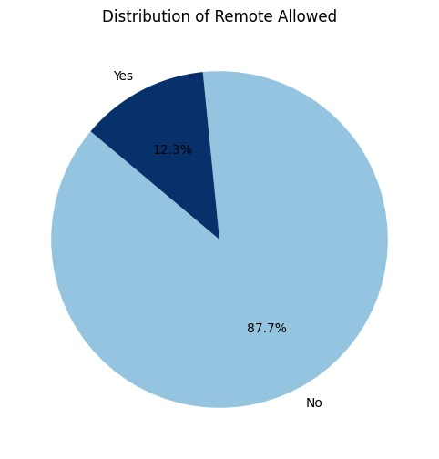
EDA Using Python
Distribution of Remote Allowed

Slide 21
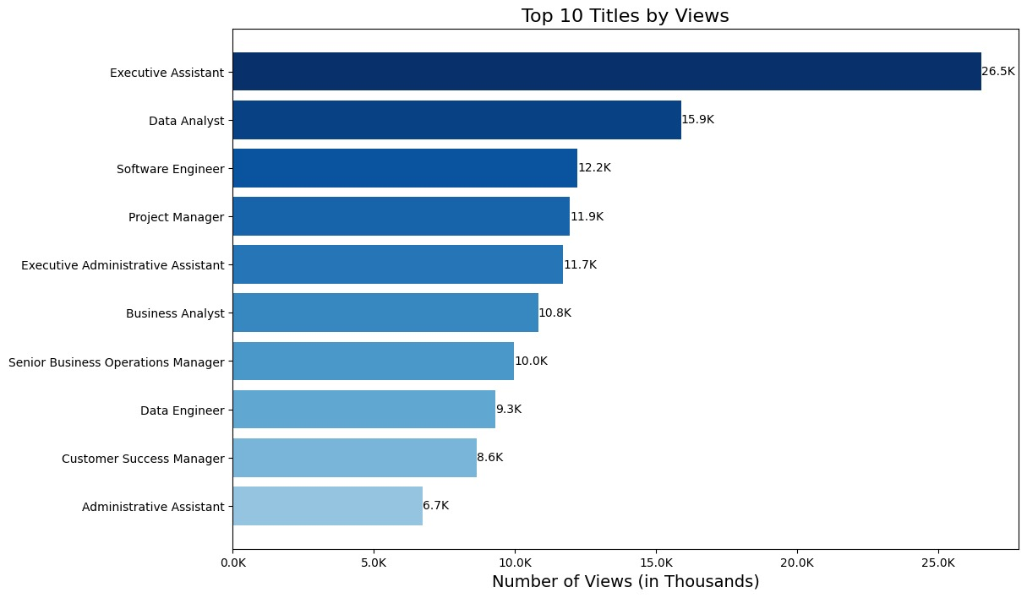
EDA Using Python
Top 10 Titles by Views

Slide 22
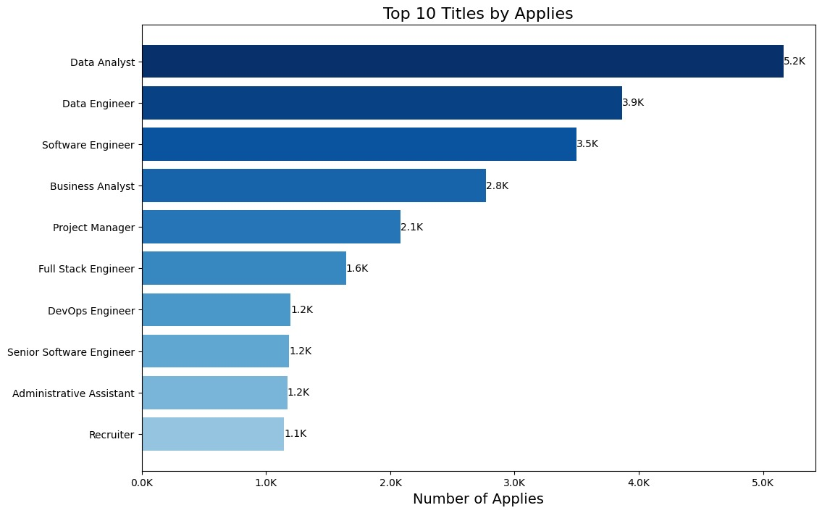
EDA Using Python
Top 10 Titles by Applies

Slide 23
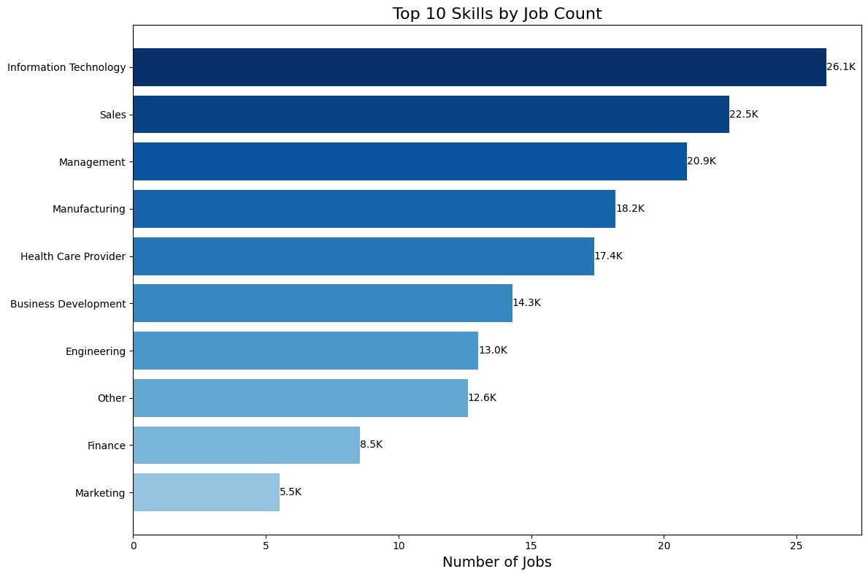
EDA Using Python
Top 10 Skills by Job Count

Slide 24
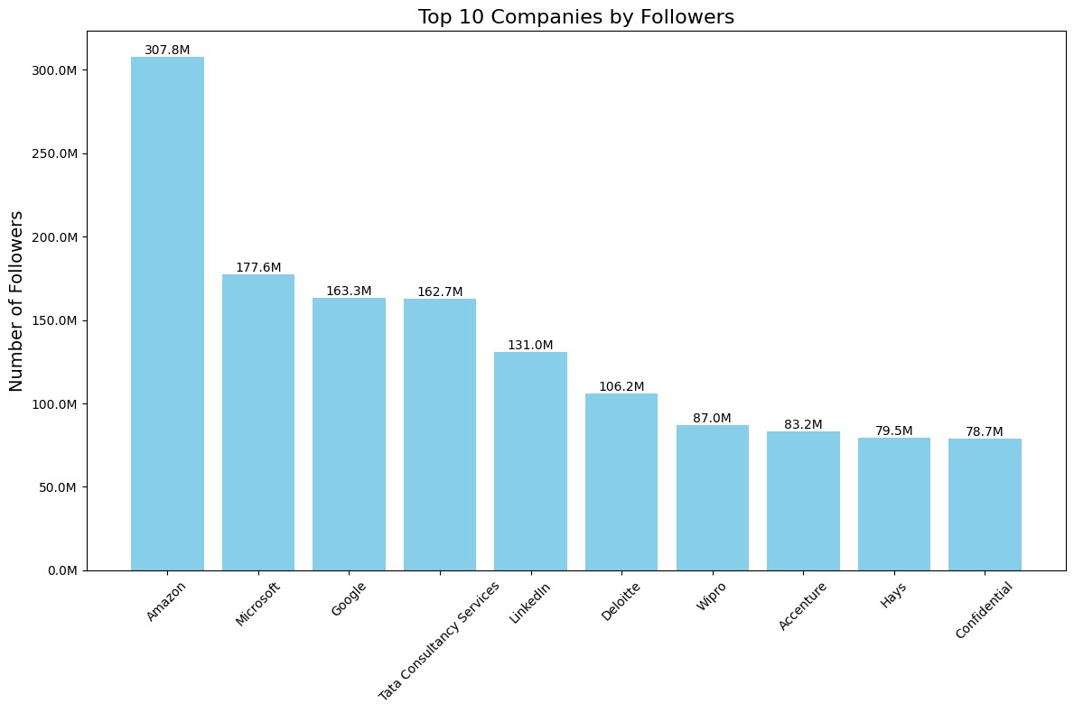
EDA Using Python
Top 10 Companies by Followers

Slide 25
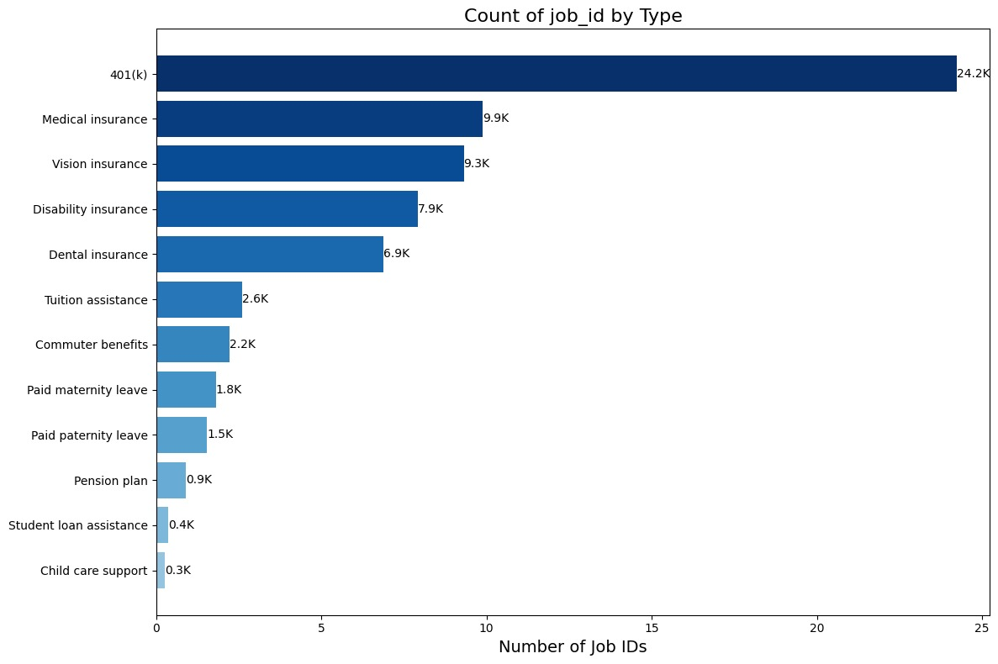
EDA Using Python
Count of Job_id by Type

Slide 26
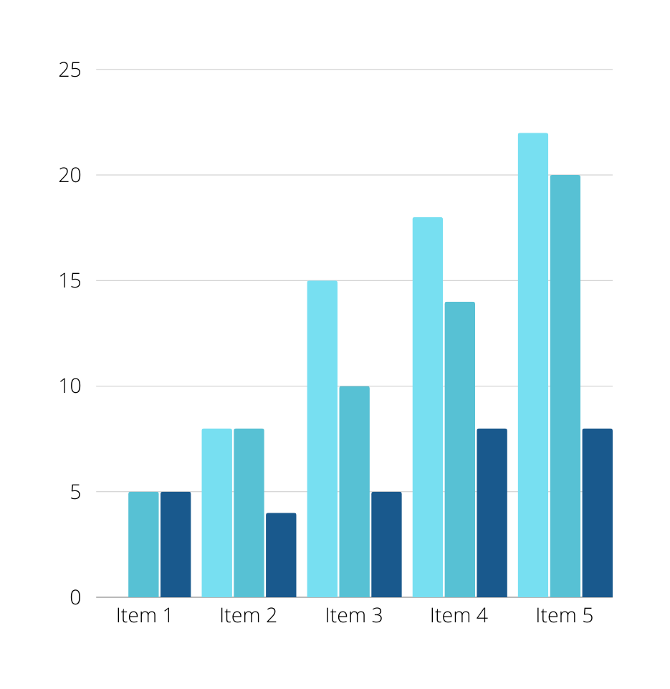
Dashboard
The following Dashboards were created Using Tableau

Slide 27
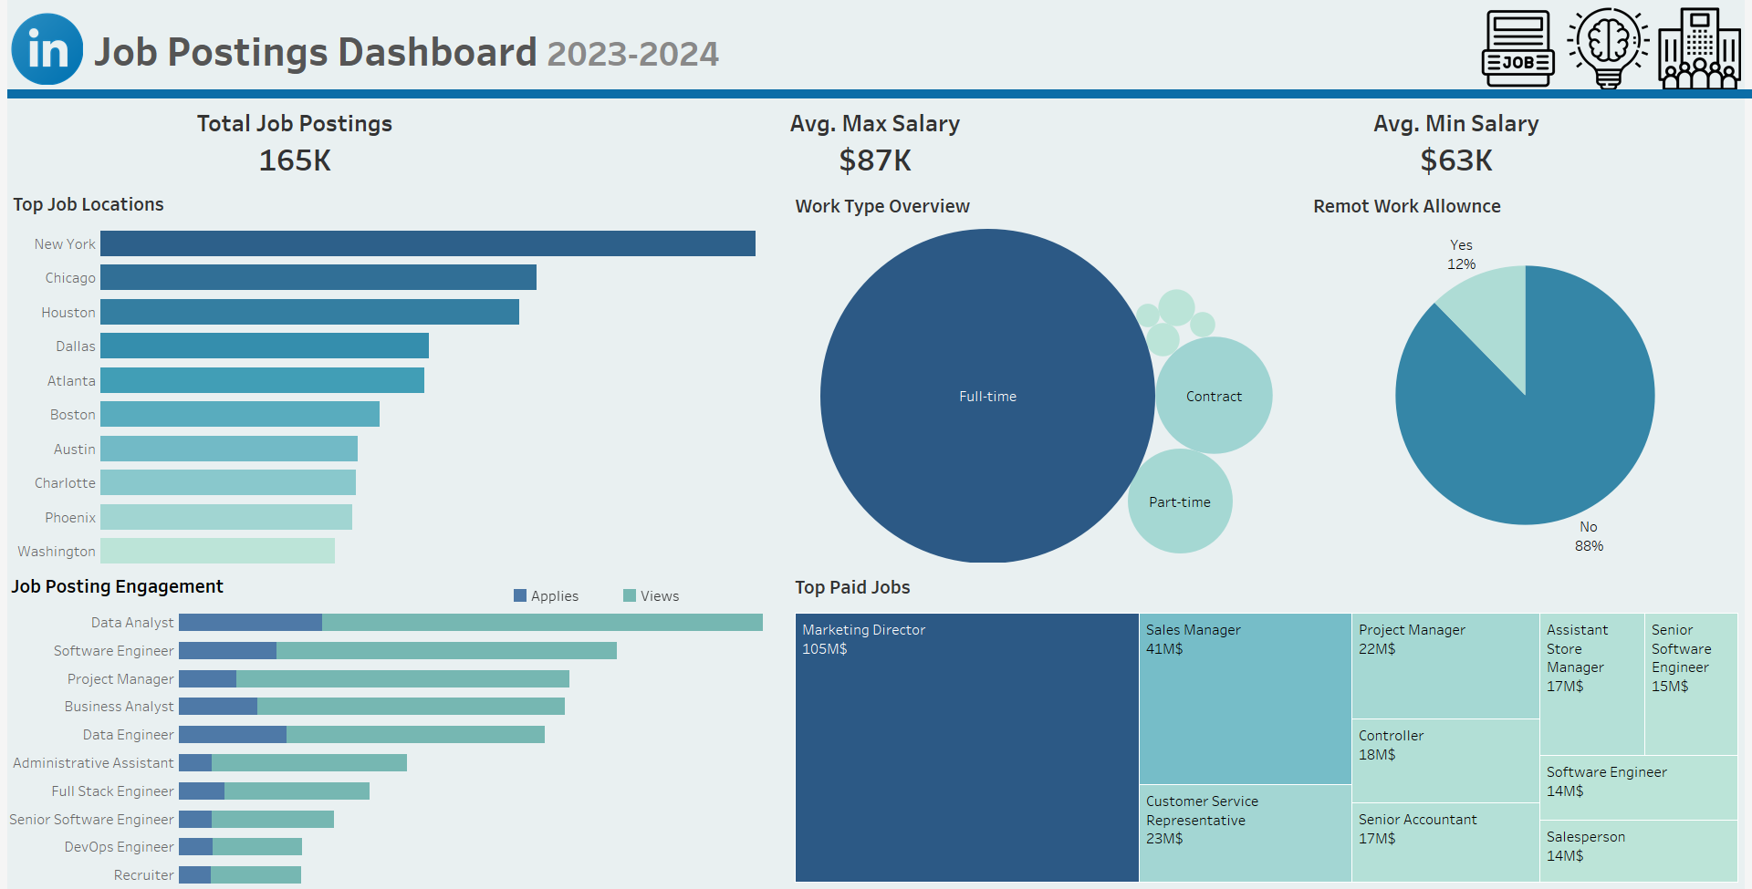

Slide 28
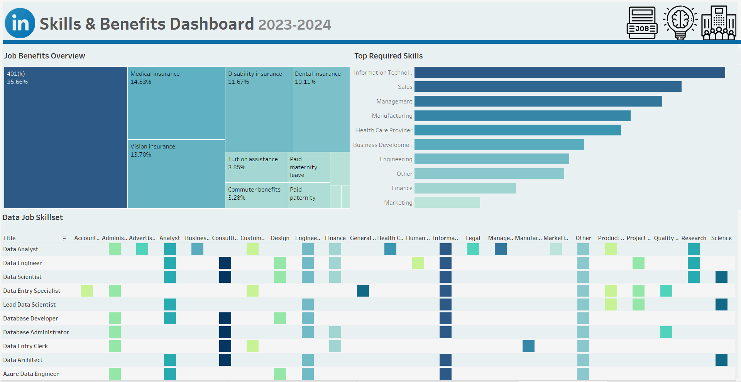

Slide 29
